Slide 1
Digital Business and E-Commerce Management
Lesson 1
Introduction to Digital Business & E-commerce

Slide 2
Introduction to Digital Business & E-commerce
At the end of this lesson, you will be able to:
Define the meaning and scope of digital business and e-commerce and their different elements
1
Summarize the main reasons for adoption of digital business and barriers that may restrict adoption
2
Outline the on-going business challenges of managing digital business in an organization, particularly online start-up of business
3

Slide 3
Activity 1.1
Refer to your book for Activity 1.1

Slide 4


Introduction
Organizations have now been applying technologies based on the following:
Internet
World Wide Web
Wireless communications
Deploying these technologies has offered many opportunities for innovative e-businesses to be created based on new approaches to business.

Slide 5

The impact of electronic communication in traditional business
Innovation in e-business is relentless, with the continuous introduction of new technologies, new business models and new communications approaches.

Slide 6
The impact of electronic communication in traditional business
For example, many business are reviewing the benefits, costs and risks of digital business technologies they are currently implementing as part of digital business transformation.

Slide 7
The impact of electronic communication in traditional business
Key opportunities of digital transformation open to most businesses:
Inbound Marketing
Mobile Marketing

Slide 8
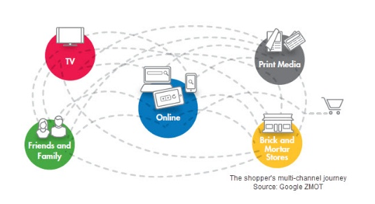
Inbound Marketing
The impact of electronic communication in traditional business
A summary of today’s multichannel consumer decision-making for product purchase where they search, review ratings, styles, prices and comments on social media before visiting retailer.

Slide 9
Inbound Marketing
The impact of electronic communication in traditional business
The consumer is proactive in actively seeking out information for their needs, and interaction with brands are attracted through content, search and social media marketing.

Slide 10


Content Marketing
The impact of electronic communication in traditional business
The management of text, rich media, audio and video content aimed at engaging customers and prospects to meet business goals, published through print and digital media including web and mobile platforms.
The contents are repurposed and syndicated to different forms of web presence such as publisher sites, blogs, social media and comparison sites

Slide 11
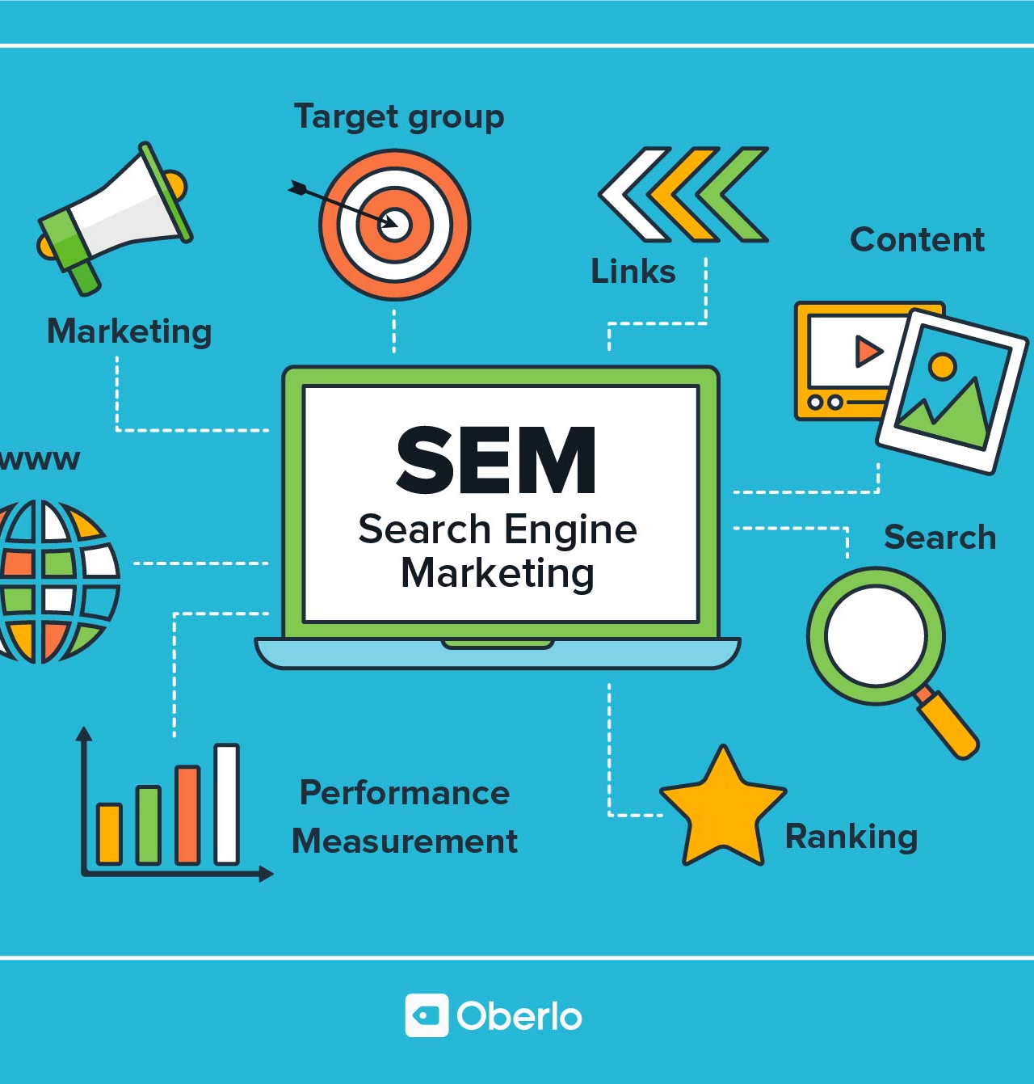
Search Marketing
The impact of electronic communication in traditional business
Companies search to improve their visibility in search engine for relevant search terms by increasing their presence in the search engine result pages

Slide 12
Activity 1.2
Refer to your book for Activity 1.2

Slide 13





Social Media Marketing
The impact of electronic communication in traditional business
Monitoring and facilitating customer-customer interaction and participation throughout the web to encourage positive engagement to its company and its brand.

Slide 14
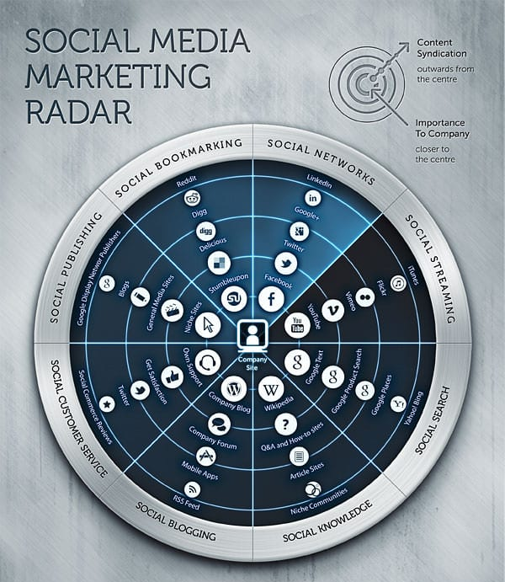

Slide 15
The impact of electronic communication in
traditional business
Since there are so many types of social presence, it is helpful to simplify the options to manage them. Six recommended categories based in Weinberg:
Social Networking
Social Knowledge
Social Sharing
Social News
Social Streaming
Company user-generated content and community

Slide 16
Activity 1.3
Refer to your book for Activity 1.3

Slide 17

Mobile Marketing (M-Commerce)
The impact of electronic communication in traditional business
Electronic transactions and communications conducted using mobile devices such as smartphones and tablets and typically with a wireless connections.

Slide 18


What is the difference between digital business and e-commerce?

Slide 19
E-commerce
Difference between digital business and
e-commerce
The scope of e-commerce is narrower than digital business.
It is referred to as buying and selling using the Internet.
All electronically mediated transactions between an organization and any third party it deals with.

Slide 20
Perspective of E-commerce
Difference between digital business and
e-commerce
Communication
Business Process
Service
Online
The delivery of information, products, services, payments, etc. by electronic means
The application of technology towards automation of business transactions and workflows
Enabling cost cutting at the same time as increasing the speed and quality of service delivery
Buying and selling of products and information online

Slide 21
Digital Business
Difference between digital business and
e-commerce
It has a broader scope than e-commerce.
It is similar to E-business
Business apply digital media to improve the competitiveness of the organization through optimizing processes with online and traditional channels to market and supply.

Slide 22
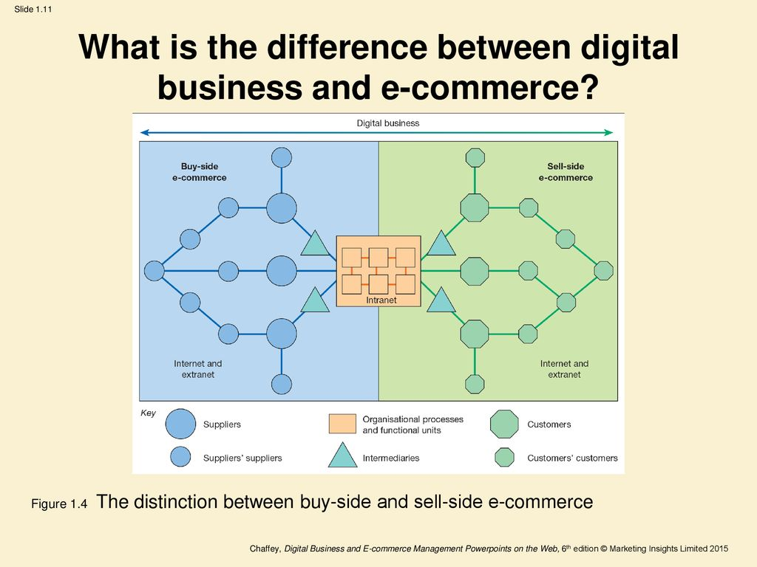

Slide 23
Activity 1.4
Refer to your book for Activity 1.4

Slide 24
Types of Sell-side E-commerce
Transactional E-commerce site
These enable purchase of products online.
Service-oriented relationship-building websites
Provide information to stimulate purchase and build relationships.
Brand-building sites
Provide an experience to support the brand. Products are not typically available for online purchase.
Publisher or media sites
Provide information, news or entertainment about a range of topics. ‘Portal’ refers to a gateway of information.
Social Network sites
It is considered as part of the previous category.

Slide 25
Digital Marketing
Digital Marketing Involves:
Applying this technology which forms online channels to market
Web, e-mail, databases, plus mobile/wireless and digital TV.
To achieve this objectives:
Support marketing activities aimed at achieving profitable acquisition and retention of customers … within a multi-channel buying process and customer lifecycle.
Through using this marketing tactics:
Recognizing the strategic importance of digital technologies and developing a planned approach to reach and migrate customers to online services through e-communications and traditional communications. Retention is achieved through improving our customer knowledge (of their profiles, behavior, value and loyalty drivers), then delivering integrated, targeted communications and online services that match their individual needs.

Slide 26
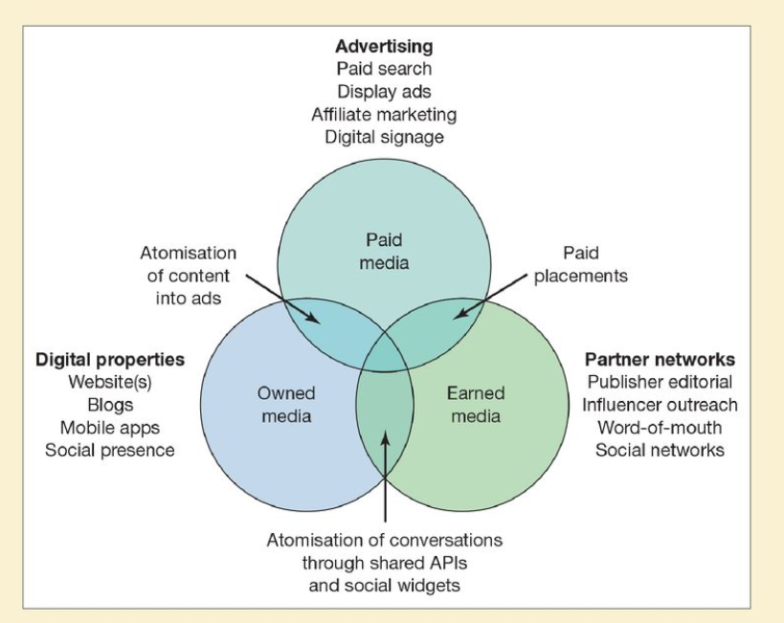
Options for Company to reach their audience online

Slide 27
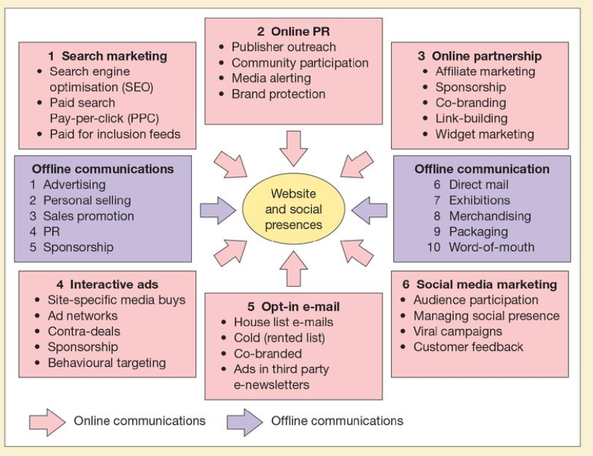
Digital and Offline Communication Techniques

Slide 28
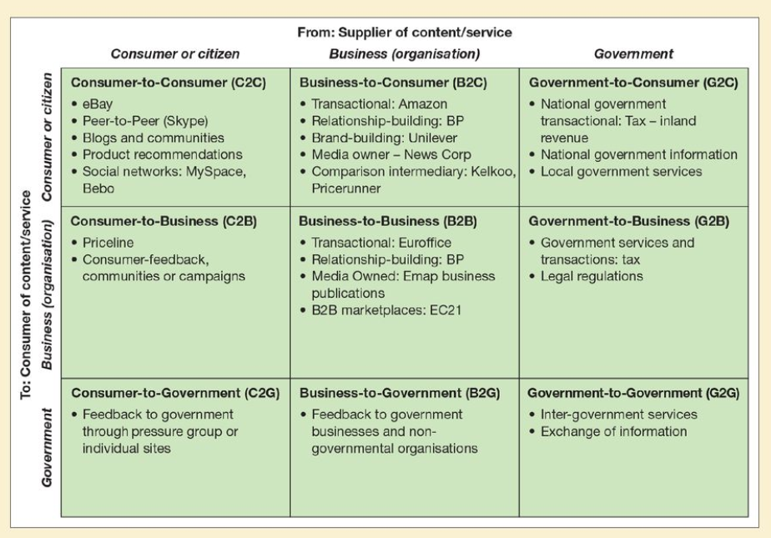
Summary and examples of transaction alternatives between businesses, consumers, and government organizations

Slide 29
Digital Business Opportunities
Reach
Over 1 billion users globally
Connect to million of products
Richness
Detailed product information on 20 billion+ pages indexed by Google, Blogs, videos, feeds
Personalized messages for users
Affiliation
Partnership are key in the networked economy

Slide 30
What can go wrong in a transactional site?

Slide 31
Potential Answers
Site downtime affecting whole site or some processes
Security attack e.g. denial-of-service attack, content hijacked
Wrong content presented for site visitor

Slide 32
Activity 1.5
Refer to your book for Activity 1.5

Slide 33
Drivers of digital technology adoption
Digital Business Opportunities
Cost/Efficiency drivers
Increasing speed with which supplies can be obtained
Increasing speed with which goods can be dispatched
Reduced sales and purchasing costs
Reduced operating costs
Competitiveness drivers
Customer demand
Improving the range and quality of services offered
Avoiding losing market share to businesses already using e-commerce

Slide 34
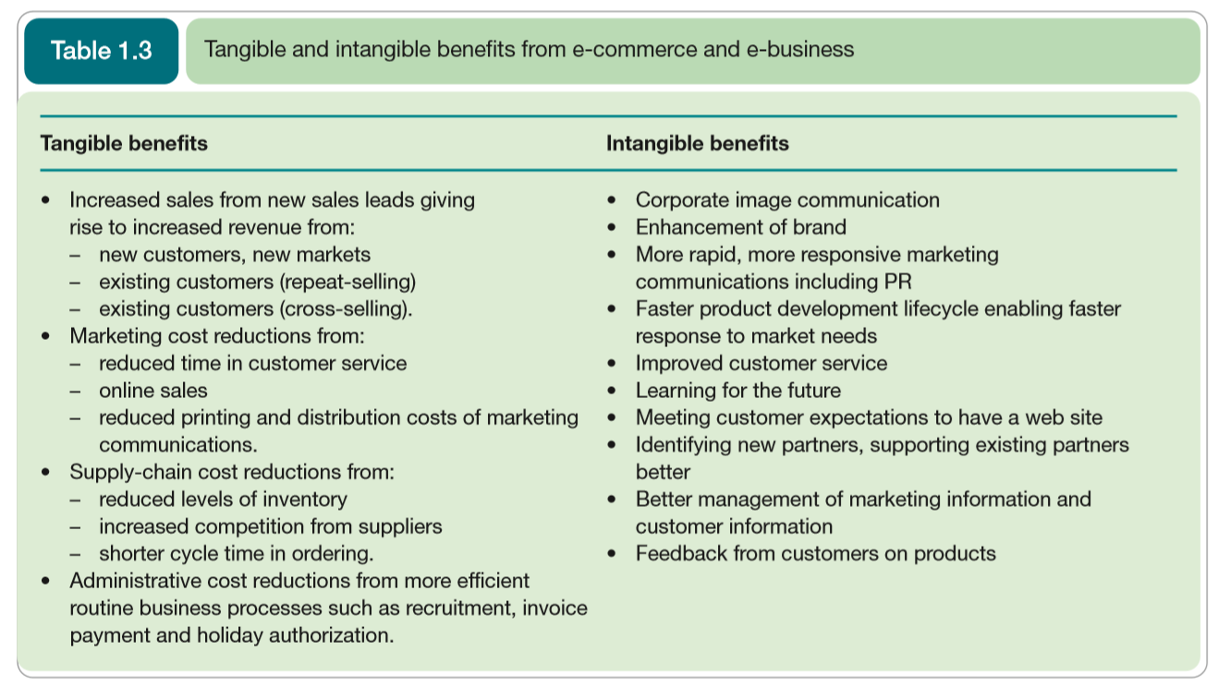
Digital Business Opportunities

Slide 35
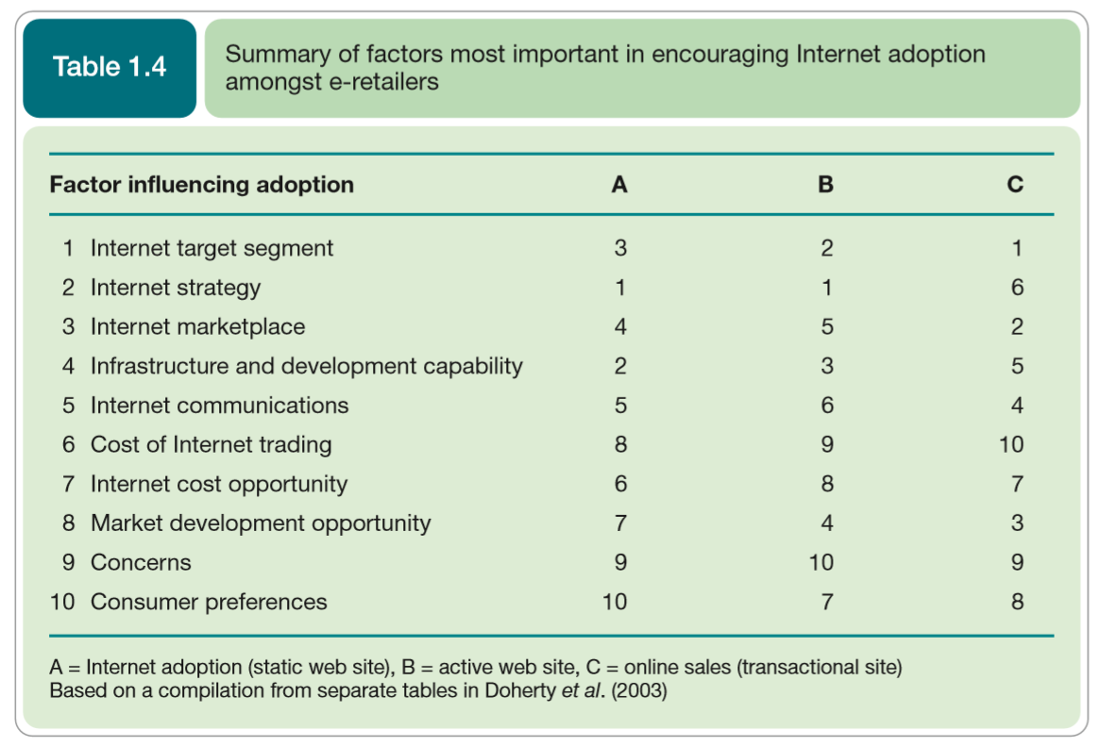
Digital Business Opportunities

Slide 36
Risk and barriers to digital business adoption
One of the main strategic risks is making the wrong decision about digital business investments.
Examples of poor online customer experiences:
Web sites that fail because of a spike in visitor traffic after a peak-hour TV advertising campaign.
Hackers penetrating the security of the system and stealing credit card details.
A company e-mails customers without receiving their permission, so annoying customers and potentially breaking privacy and data protection laws.
E-mail customer-service enquiries from the web site don’t reach the right person and are ignored.

Slide 37
Risk and barriers to digital business adoption
Barriers to consumer Internet adoption:
No perceived benefit
Lack of trust
Security problems
Lack of skills
Cost

Slide 38
Evaluating an organization’s digital business capabilities
Assessment of an organization’s existing digital business capabilities is a starting point for the future development of their digital business strategy

Slide 39
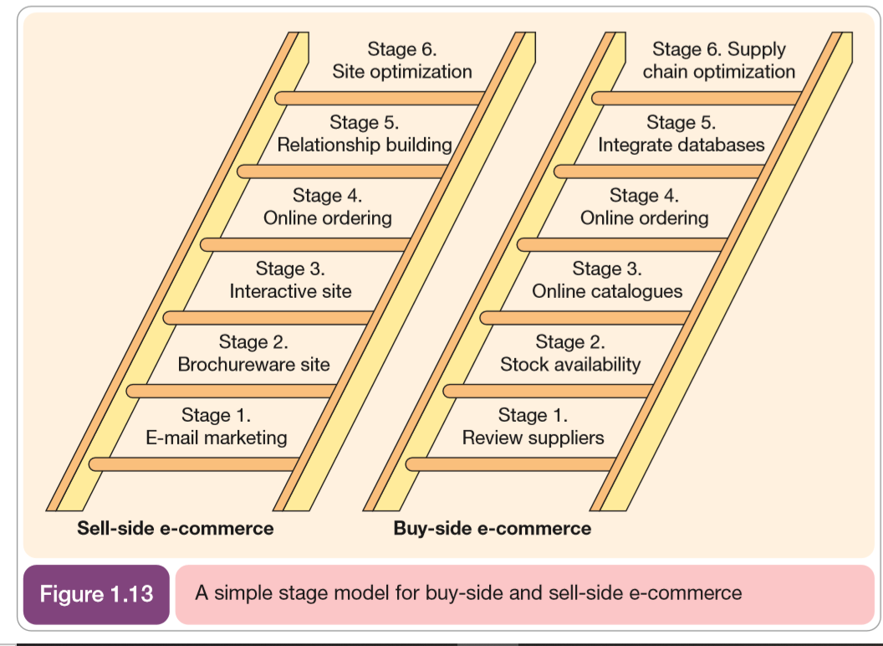
Evaluating an organization’s digital business capabilities

Slide 40
Self-Assessment Questions
Refer to Activity booklet for questions which will help you review the topics covered in this lesson.

